Slide 1
Dengue Fever
Course Name
Professor’s Name
Student’s Name

Slide 2
Introduction
Dengue fever is mosquito caused viral infection.
The disease is caused bites from female aedes mosquito.
The virus that causes Dengue disease is called DENV-4
Its signs and symptoms such as nausea/vomiting, rash and fatigue are the leading indicators.
Notes:
Dengue fever is mosquito caused viral infection. Particularly the disease is caused bites from female aedes mosquito. Existence of female aede mosquitos has been found to regenerate with the continued unplanned human settlement. Research studies also indicate that the disease thrives in tropical regions and in trappings characterized through unhygienic human practices. Dengue fever’s virus is call DENV-4 bearing its four regenerating viral serotypes. This conceptually means that the disease can affect a person up to four times. There are indications according to World Health Organization and CDC reports showing that one among the four serotypes has the ability to act as antibodies preventing uncontrolled spread. This fact is only verifiable through vaccine creation. Like other biohazard viruses, dengue fever is transferred from an infected person to another through the continuous bite by the same aedes mosquito. Advanced nurses and virologists suggest various practices can practically be done to prevent spread of the disease. For signs and symptoms such as nausea, vomiting, rash and fatigue, pharmacological interventions are the remedy. This presentation gives a more precise attention to the concepts of Dengue Fever by looking in in-depth risk factors, progression of the disease, diagnosis and prevention measures.

Slide 3
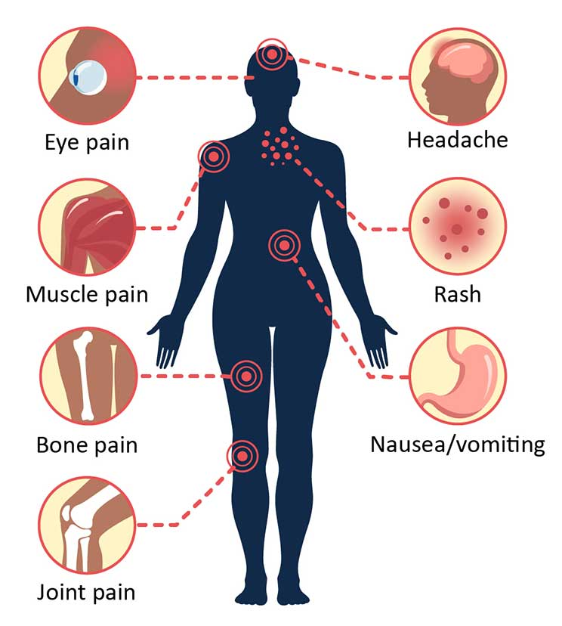
Dengue’s Risk Factors
The risk factors of the disease looks at causative factors, signs and symptoms and progression to other advanced stages.
Notes:
The risk factors of the disease looks at causative factors, signs and symptoms and progression to other advanced stages. What begins with single mosquito bites if unchecked corresponds to underlying body responses such headache, breathing problems, fever, pain behind the eyes, muscle and joint pain as discussed by Khetarpal & Khanna (2016). These are risks which are easily dismissible to other common illnesesses due to other factors. Xavier-Carvalho et al. (2017) describe that Dengue Fever symptoms should be checked and corrected failure to which shall lead to defects in certain body organs, tissues and organ functioning. Severe dengue causes other serious standards of the infection such as dengue hemorrhagic fever and shock syndrome. Treatment of the disease in the form of exemplified vaccination has not been fully developed or accredited making it improbable to reverse the extreme risk conditions associated with advanced stages of the disease.

Slide 4
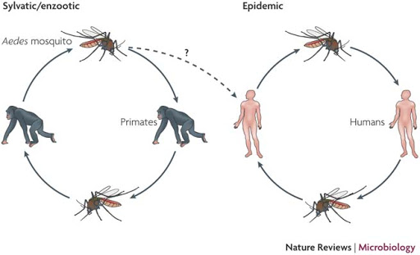
Continuation on Risk Factors…
A single bite from the mosquito leads to extreme endemic conditions of the Dengue Fever disease.
Dengue Fever is correlation in spread even among the primate animals.
Notes:
Recognizing the warning signs of dengue fever is important in classifying the adequacy of the signs and symptoms. This fever is generational even in the primate animals like chimpanzees. Understanding how it spreads is very significant for people in prone areas. Research by Xavier-Carvalho et al. (2017) found that Dengue Fever can present itself in many forms. From the single mosquito bite, the virus can replicate into maculopapular rash in children. The same bite by a single mosquito can infect another person or animal. At this point, the bite effect will appear more flulike in children or older adult before progressing to the rest of the body. Other diseases such as Influenza, Measles, Rubella, Malaria and Typhoid fever as discussed by Khetarpal & Khanna (2016), are indicative of similar signs and symptoms. Ruling out the possibilities of the risk factors during the diagnosis ensures that the treatment only deals with the Dengue Fever and no other disease.

Slide 5
Progression from Initial Injury to Tissue and Organ Defects
When dengue virus infects the body, the bite containing the virus replicates in the body cells from the skin epithelium.
The viral infection can transcend and affect the dendritic and mononuclear cells.
The worst case scenario of the disease takes place when the virus spreads to plasma causing the leakage.
Notes:
When dengue virus infects the body, the bite containing the virus replicates in the body cells from the skin epithelium. Khetarpal & Khanna (2016) discuss that the viral infection can transcend and affect the dendritic and mononuclear cells. Because the virus has the ability to stay viable in the human’s systems for up to seven days, it is discussed that the virus can subsequently attack the lymphnodes and circulatory organs. Chatterjee et al. (2017) discuss that without proper correlation and determination of the viral infection, the body organs such as the liver, spleen and lungs can equally get infected. The worst case scenario of the disease takes place when the virus spreads to plasma causing the leakage. On the same note, the organs mentioned herein destabilize in their functions due to extended defects of the virus.

Slide 6
Continuation on Progression from Initial Injury to Tissue and Organ Defects
An impairment in one area of the body results to a given degree of malfunction in another area.
When Dengue Virus attacks the epithelial cells of the skin, the virus affects the circulatory systems due to replication of the viral cells.
Dengue fever leads to platelets malfunction which is associated with plasma leakage, fever, and thrombocytopenia
Notes:
The body organ system is made in a complimentary or integrated method that appreciates organ functionalities. An impairment in one area could possibly result to a similar impairment in another tissue, organ or system fuctionality. When Dengue Virus attacks the epithelial cells of the body, the infection also dissociates functionality of major organs of the body like Spleen. Depending on the degree of the infection, advanced Dengue infection leads to hemorrhage effects of the disease. Hemorrhage Dengue implies to severe bleeding through the gums, nose and bruising as shown by Chatterjee et al. (2017). Severe bleeding raptures the circulatory systems. Platelets are exposed to air leading to their malfunctions. This platelets malfunction is associated with plasma leakage, fever, and thrombocytopenia as summed by Chatterjee et al. (2017). These malfunctions are the leading causes of fatal cases in countries where Dengue Hemorrhage Fever has been reported.

Slide 7
Changes in the Tissue and System Functioning from Signs and Symptoms
DENV Virus releases undetermined alteration to the tissue cells.
The disease, likewise, develops in people whose immune systems are low due to other underlying disorders.
The body functional systems such as respiratory system becomes impeded when the viral infection has blocked the airways.
Notes:
When the virus infects the host body tissues for the first time, it is referred to as the primary infection. This can be treated by simpler medicinal approaches. A subsequent infection on the same host is termed as the secondary infection. At this point the DENV Virus releases undetermined alteration to the tissue cells (Jajarmi, Arshad & Baleanu, 2019). The disease, likewise, develops in people whose immune systems are low due to other underlying disorders. The body functional systems such as respiratory system becomes impeded when the viral infection has blocked the airways. Transportation of gases become impared for the lungs fail to function properly. In most cases the patients at this point require immediate assistance in breathing either through suctioning or artificial ventilators. Other system functioning such as excretion through the liver secretion may become drastically impaired due the spread to the virus as discoursed by Jajarmi, Arshad & Baleanu (2019).

Slide 8
Diagnosis of Dengue Fever Disease
Doctors and virologists rely on using blood sample for testing for the virus or its antibodies.
Patients’ travel history into regions prone with the infection is indicative of the virus.
Visible signs and symptoms together with travel history are leading tell-tales of the virus probability.
Notes:
Very often than not, doctors and virologists rely on using blood sample for testing for the virus or its antibodies. Testing using blood samples is guided by the patient’s elaboration of journey history can help physicians to vividly test for the presence of the infection. Chatterjee et al. (2017) posit that cross regional movements into places known to be inhabited by aedes mosquitos is indicative of the signs that someone could be having the viral infection. There are various factors that can be used as tell-tales for the existence of the viral disease. Diagnosis will heavily rely on using patient’s history as well as visible signs. During the diagnosis, possibilities of other illnesses with similar signs are ruled out.

Slide 9
Pharmacological Interventions
Pharmacological interventions are medical methods put forward to treat and manage the disease.
Depending on the degree of the disease, different treatment methods can be used.
The use of acetaminophen or paracetamol has been found to repress pain related to the infection.
Notes:
Pharmacological intervention measures are methods that medical practitioners and scientific research studies on the disease have put forward to treat and manage the disease. Depending on the degree of the disease, different treatment methods can be used. For verified mild infections, the use of acetaminophen or paracetamol has been found to repress pain related to infection (Chatterjee et al., 2017). Although the duration of the viral infection can be limited, the infection has the ability to remain within the body cells for longer durations. There are vaccine trials that have been envisioned to help curb the replication of Dengue viral cells. Furthermore, the use electrolytes have similarly been found to replenish lost fluids from the high fever and other dehydration implications of the disease like sweating (Jajarmi, Arshad & Baleanu, 2019). These pharmacological interventions are utilized in many cases because there has not been any particular treatment method for the disease.

Slide 10
Continuation on Pharmacological Interventions
The clinicians posit that it is acceptable to treat the symptoms as seen in the patient.
Back and joint pains can be treated by analgesics.
There are also vaccines that include inactivated virus vaccines, viruslike particles, and DNA vaccines.
Notes:
Giving factual testimony of no specific treatment methods available for Dengue Fever implies that there are other peripheral modes that could be used to manage the disease. In this case, the clinicians posit that it is adequate to treat the symptoms as seen in the patient. Fever on its own can be managed using paracetamol while it is logical and medicinal to ease back and joint pains by specified analgesics as reported by Chatterjee et al. (2017). In addition, it is noteworthy to state that these intervention approaches are only for the mild diagnostically verified Dengue symptoms. There are also experimental Dengue vaccines in given phases and in different trial stages. These vaccines include inactivated virus vaccines, viruslike particles and DNA vaccines (Chatterjee et al., 2017). They are characteristically non-replicating giving them fair advantage over others in the developing stages.

Slide 11
Dengue Vaccines
Vaccines are supposed to prevent the replication or reoccurrence of the viral infection in the body.
The renowned vaccines with their corresponding source of funding include DENV-2, 16,681, PDK53.
DENV-2/4d30 is an additional vaccine in more advanced phase one and two of piloting.
Notes:
Vaccines are supposed to prevent the replication or reoccurrence of the viral infection in the body. Dengue Vaccines are very many but those which have been piloted have had divergent degrees of trial outcomes and others with side effects dreary than the effects of Dengue hemorrhagic complications. The renowned vaccines with their corresponding source of funding include DENV-2, 16,681, PDK53 funded by the Center for Disease Control and Prevention in United States. This vaccine sample is in preclinical stage. Processes to complete its functions are still investigated. Additionally, another prominent vaccine as stipulated by Khetarpal & Khanna (2016) is DENV-2/4d30. Its prominence is attributed to completion of the first and second phases of vaccine trial. It covers all the four serotypes that Dengue Virus causes. The vaccine was developed and sponsored by the double efforts of National Institute of Allergy and Infectious Diseases and National Institutes of Health as compiled by Khetarpal & Khanna (2016).

Slide 12
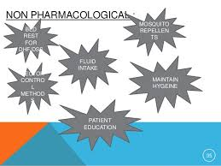
Non-pharmacological Intervention
Non-pharmacological interventions are non-medicinal approaches put in place so as to prevent attracting the disease.
Notes:
Non-pharmacological interventions are non-medicinal approaches put in place so as to prevent attracting or spread of the disease. Virologists and researchers have put forward certain these measures as told by Jajarmi, Arshad & Baleanu (2019). The measures include sleeping under treated mosquito nets or using mosquito repellants, clearing bushy vegetation around dwellings, patient education, ample fluid intake and emptying stagnated water cans. It is equally advisable to make plans before venturing out on journey destinations into areas prone to the virus spread and breakout. Government officials and urban planning agencies are supposed to be guided through environment regulating agencies so as to set up settlements in areas verified as adequate to their sustainability. Frequent check ups for elaboration of signs and symptoms is key to keeping off the spread of the virus (Jajarmi, Arshad & Baleanu, 2019). Individuals are equally advised to take precautionary measures that include physical body hygiene as a method of keeping other infections at bay.

Slide 13
Continuation on Non-pharmacological Intervention
The government of Dengue prone regions should formulate and fund screening policies that aim to keep people safe from the virus.
Screening informs the people on the other illnesses that could be underlying.
Urban policies that regulate settlements should be implemented to reduce risks associated with Dengue Virus.
Notes:
Government policies are required to change certain societal behaviors. The government especially from the Dengue prone tropical regions should formulate and fund screening policies that aim to keep people safe from the virus. Screening informs the citizens on the right approaches to lifestyle living conditions. As told by Khetarpal & Khanna (2016), screening informs the people on the other illnesses that could be underlying. Equally, policies that regulate urban settlement need to be implemented by all standards so as to reduce the risk factors associated with the disease springing from unhygienic contaminations characterized by open gutters and trenches which are breeding grounds for mosquitos. Furthermore, countries that seek to use conventional vaccines should have their governments taking needed responsibility because some of the available vaccines possess array of inadequacies. As demonstrated Jajarmi, Arshad & Baleanu (2019), during the pretrial stages of DENV-2/4 d 30 vaccines, it became evident that using the vaccine had effects on the older people especially those with additional illnesses or lowered immune systems.

Slide 14
Role of Nurse Practitioner in Disease Prevention, Diagnosis and Management
Professional training equips nurses at all times with the necessary intervention measures for patients.
Incorporating competency and the relevant ethical guidelines helps in the diagnosis of diseases
Nurses should disseminate information regarding the contact and spread of diseases in their settings.
Notes:
Medical nurse practitioners are professionally trained so as to be equipped at all times with the necessary intervention measures for patients. By incorporating competency and the relevant ethical guidelines, a nurse practitioner should be able to distinguish which condition a patient suffers from so as to prevent them from going into shock syndromes or other severe Dengue complications as shown in the findings by Xavier-Carvalho et al. (2017). In order to prevent the spread or simply the contact with Dengue Fever, a nurse practitioner should be able to advocate for hygienic conditions in their residential settings and within the hospital setting. They get to disseminate relevant information related to the people so as to prevent the disease as discussed by Xavier-Carvalho et al. (2017). When the nurse is adequately equipped with skills and training programs, they easily diagnose all the diseases according to the signs they portrayed.

Slide 15
Continuation on the Nurse Practitioner’s Roles
Nurse practitioners are required to know all the processes needed in managing patients in intensive care units.
Patients with underlying conditions such as asthma and other respiratory illnesses require ardent and compassionate care.
The nurse’s role is to ensure that procedures such as inducing sugar molecules to the patient takes place.
Notes:
Advanced nurse practitioners are required to know all the procedures required in managing patients in intensive care units. These are patients who have been affected drastically by the Dengue virus. Patients with underlying conditions such as asthma and other respiratory illnesses require ardent and compassionate care from the nurses so as to live through the treatment. It is the nurse’s role to ensure that procedures such as inducing sugar molecules to the patient takes place as illustrated by Khetarpal & Khanna (2016). Khetarpal & Khanna (2016) are required professionally to form alliances or correlational rapport with their patients so as foster compassionate care. There are nurses with advanced training on the correct leadership measures. These skills are impactful in managing conflicts and important decisions that affect the patients and the hospital staff. Equally, the training on leadership should be able to equip nurses with diagnostic skills required to complete tests on the patient.

Slide 16
Conclusion
Advanced clinical practitioners are bound by obligations and principles to bolster a positive approach in addressing Dengue Fever.
Dengue Fever starts by a bite from infected Aedes albopictus mosquitoes.
The infection ends up impeding the body organs such as the lungs, liver and spleen such that these organs become impaired.
Notes:
Understanding the details about an infectious disease not only rests on the shoulders of scientific researchers but also on the nurse practitioners who are to handle the patients. Advanced clinical practitioners are bound by obligations and principles to bolster a positive approach in addressing Dengue Fever. What starts a simple bite by Aedes albopictus mosquitoes may end up impeding the body organs such as the lungs, liver and spleen such that these organs become impaired. Unchecked Dengue Fever infection can be fatal if the risk factors are not adequately encountered. People who travel or have history of travel to mosquito prone areas not only risk malaria infections but also Dengue Fever. Warning signs such as fever, headaches, back and joint paints are the leading causes of Hemorrhage Dengue when the signs are ignored. Dengue Shock is an aftermath of the disease often taken to be very fatal. People should avoid unnecessary traveling to malaria prone zones, clear vegetation near dwellings and practice hygiene to prevent Dengue Fever infections. Nurses on the other hand, should be well-versed with clinical procedures required to diagnose Dengue Fever. This is because the disease has tell-tales similar to other illnesses like Typhoid Fever. Understanding the practitioner’s roles from diagnosis of a disease to treatment and management of the patient should be concepts cognizant in a nurse.

Slide 17
References
Chatterjee, S., Hore, S., Dey, N., Chakraborty, S., & Ashour, A. S. (2017). Dengue fever classification using gene expression data: a PSO based artificial neural network approach. In Proceedings of the 5th international conference on frontiers in intelligent computing: theory and applications (pp. 331-341). Springer, Singapore.
Khetarpal, N., & Khanna, I. (2016). Dengue fever: causes, complications, and vaccine strategies. Journal Of Immunology Research, 2016.
Jajarmi, A., Arshad, S., & Baleanu, D. (2019). A New fractional modeling and control strategy for the outbreak of dengue fever. Physica A: Statistical Mechanics and its Applications, 535, 122524.
Xavier-Carvalho, C., Cardoso, C. C., de Souza Kehdy, F., Pacheco, A. G., & Moraes, M. O. (2017). Host genetics and dengue fever. Infection, Genetics and Evolution, 56, 99-110.

